Slide 1
Drug abusers analysis
Guide
Dr. Abdul Nizar
UG Dean
Submitted By
Anupama Regi
MCA S4
TVE20MCA-2017

Slide 2
RELEVANCE OF THE TOPIC
Drug abuse is a noteworthy public health problem in the world. It's use can result in drug addiction, serious impairment, illness and death. So it is really very important to detect those troubles as early as possible.
There is large drugs misuse among students and it leads to addiction.
This personality disorder is drastically affecting human behavior.
Globally, the use has reached all time high. So it is very much important to overcome this pathetic situation.
For this purpose ,the Drug Abusers Analysis System will be of greater benefit to the society.

Slide 3
introduction
Drug use constitutes an important factor for increasing risk of poor health, along with earlier mortality and morbidity, and has significant consequences for society.
Drug consumption and addiction constitutes a serious problem globally.
A number of factors are correlated with initial drug use including psychological, social, individual, environmental, and economic factors. These factors are likewise associated with a number of personality traits.
Psychologists have largely agreed that the personality traits of the Five Factor Model (FFM) are the most comprehensive and adaptable system for understanding human individual differences.

Slide 4
FIVE – FACTOR MODEL
The present study adopts the well-validated Five-Factor Model of personality which comprehensively covers the five major traits that define human personality across cultures
Neuroticism (N), the tendency to experience negative emotions such as anxiety and depression;
Extraversion (E), the tendency to be sociable, warm, active, assertive, cheerful, and in search of stimulation;
Openness to Experience (O), the tendency to be imaginative, creative, unconventional, emotionally and artistically sensitive;
Agreeableness (A), the dimension of interpersonal relations, characterized by trust, modesty, and cooperativeness; and
Conscientiousness (C), a tendency to be organized, strong-willed, persistent, reliable, and a follower of rules and ethical principles.
Eg; Compared to never users, current cocaine/heroin users scored higher on Neuroticism and lower on Conscientiousness.

Slide 5
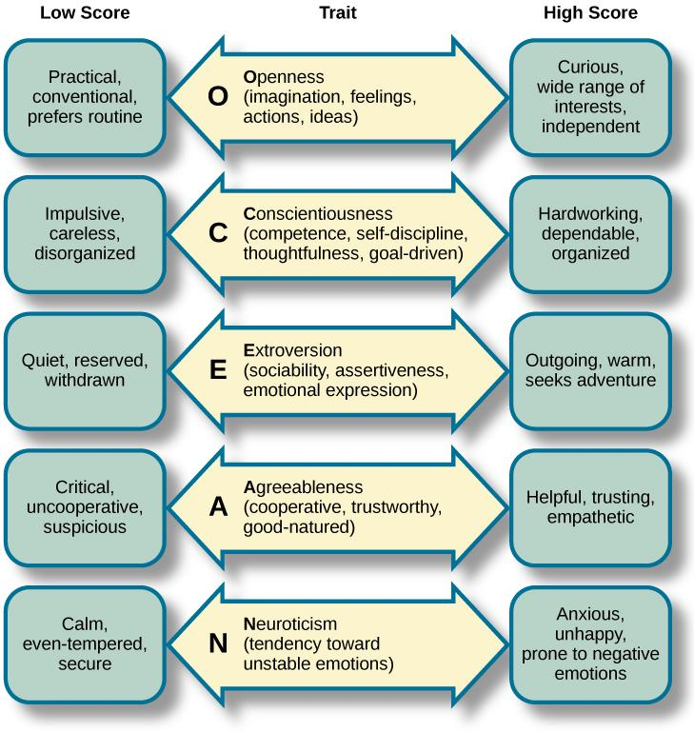

Slide 6
EXISTING SYSTEM
In the existing system, medical tests are performed with the permission of the medical officers in order to detect the drug usage among the individuals. Blood samples are collected for achieving this task, and only from the test results , we could conclude that whether the individual has taken drugs or not. In this system,
we are not able to identify how many students are using drugs
which type of drugs are used
which category are heavily addicted
relation between Education and usage of drugs etc

Slide 7
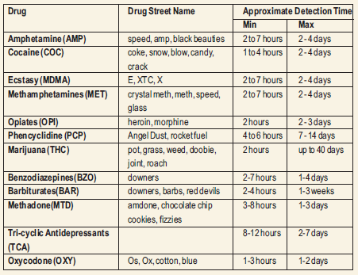

Slide 8
PROPOSED SYSTEM
The Drug Abusers Analysis System is a machine learning project which we are developing for predicting whether a student has taken any drug or not.
Each set of data can tell us a story. Our mission is to extract this story from the data and translate it into more readily accessible human language.
Problem which can be solved:
Drawbacks of existing system can be solved.
Seven class classifications for each drug separately.
Evaluation of risk to be drug consumer for each drug.

Slide 9
How our project contribute to the society
Can identify how many students are addicted to drug.
Which type of drugs are used more.
Helpful for Educational institutions, local bodies etc.
Find which type of character(personality) of an individual is involved among the abused ones.
Is Education a key factor in determining it.

Slide 10
Design
Extract needed data from the original dataset
Train model using Algorithm
Apply trained models to predict users last consumption time
Never Used
Used Last Month
Used Last Week
Used Last Year

Slide 11
DFD-Level0
DRUG ABUSERS ANALYSIS SYSTEM
USER
Input FFM Scores
Input FFM Scores
ADMIN
Result
Result

Slide 12
Process Flow
START
CLASSIFICATION
VARIOUS ALGORITHM
LOAD DATASET
UCI REPOSITORY
RESULT COMPARISON
SPLIT THE DATASET FOR TRAINING AND TESTING
STOP

Slide 13
Algorithms to be used
Support Vector Machine(SVM)
K-Nearest Neighbors (KNN)
Decision Tree (DT)

Slide 14
TOOLS
Operating System : Windows/Linux
Front end : PHP,HTML
Back end : Python
Platform : Jupyter Notebook

Slide 15
About Dataset
https://archive.ics.uci.edu/ml/datasets/Drug+consumption+%28quantied%29
Database contains records for 1885 respondents.
For each respondent 12 attributes are known: Personality measurements which include NEO-FFI-R (neuroticism, extraversion, openness to experience, agreeableness, and conscientiousness), BIS-11 (impulsivity), and ImpSS (sensation seeking), level of education, age, gender.
Alcohol, Amphet, Amyl, Benzos, Caff, Cannabis, Choc, Coke, Crack, Ecstasy, Heroin, Ketamine, Legalh, LSD(Lysergic acid diethylamide), Meth, Mushrooms, Nicotine, Semer, VSA(Volatile substance abuse) are the classes of drugs consumption.

Slide 16
Literature review
Zhaoying Qiao, Tianrui Chai,Qinjing Zhang,Xinyi Zhou,Zhuoling Chu,‘Predicting potential drug abusers using machine learning techniques’, IEEE, 13 February 2020
E. Fehrman, A. K. Muhammad, E. M. Mirkes, V. Egan and A. N. Gorban, "The Five Factor Model of personality and evaluation of drug consumption risk", IEEE, 2015.

Slide 17
screenshots

Slide 18
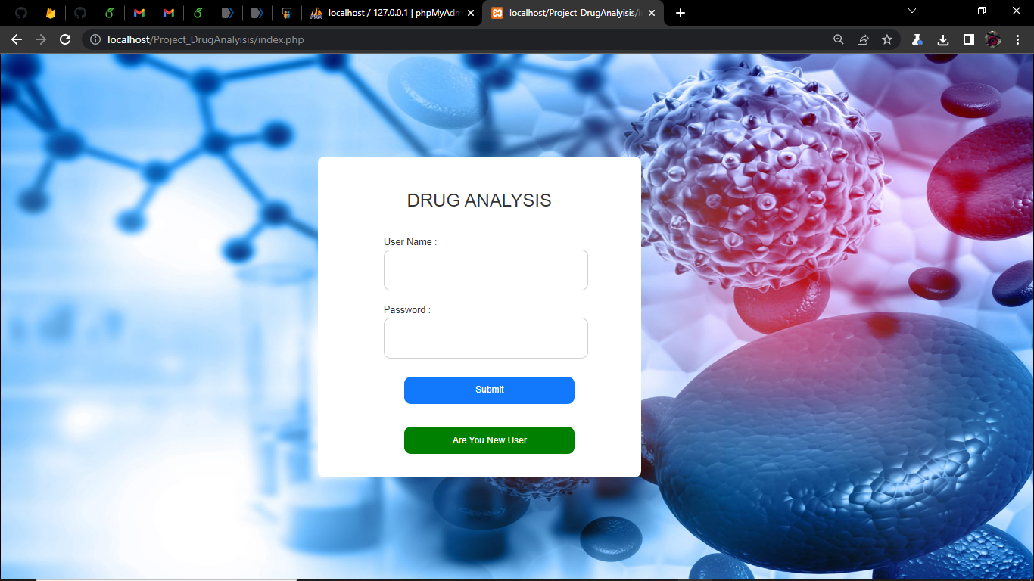

Slide 19
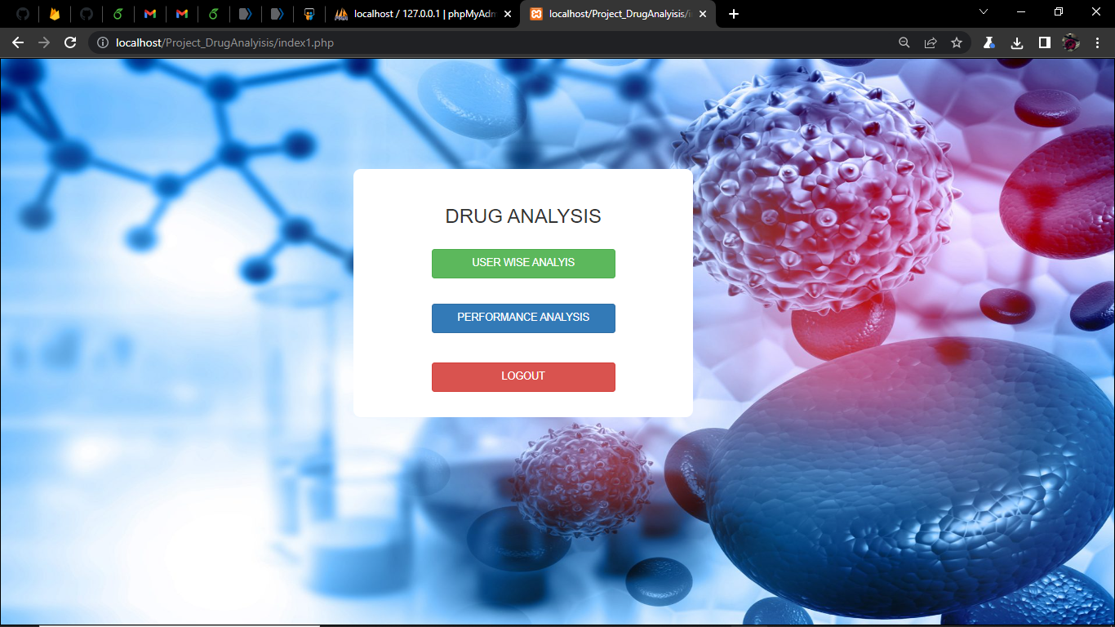

Slide 20
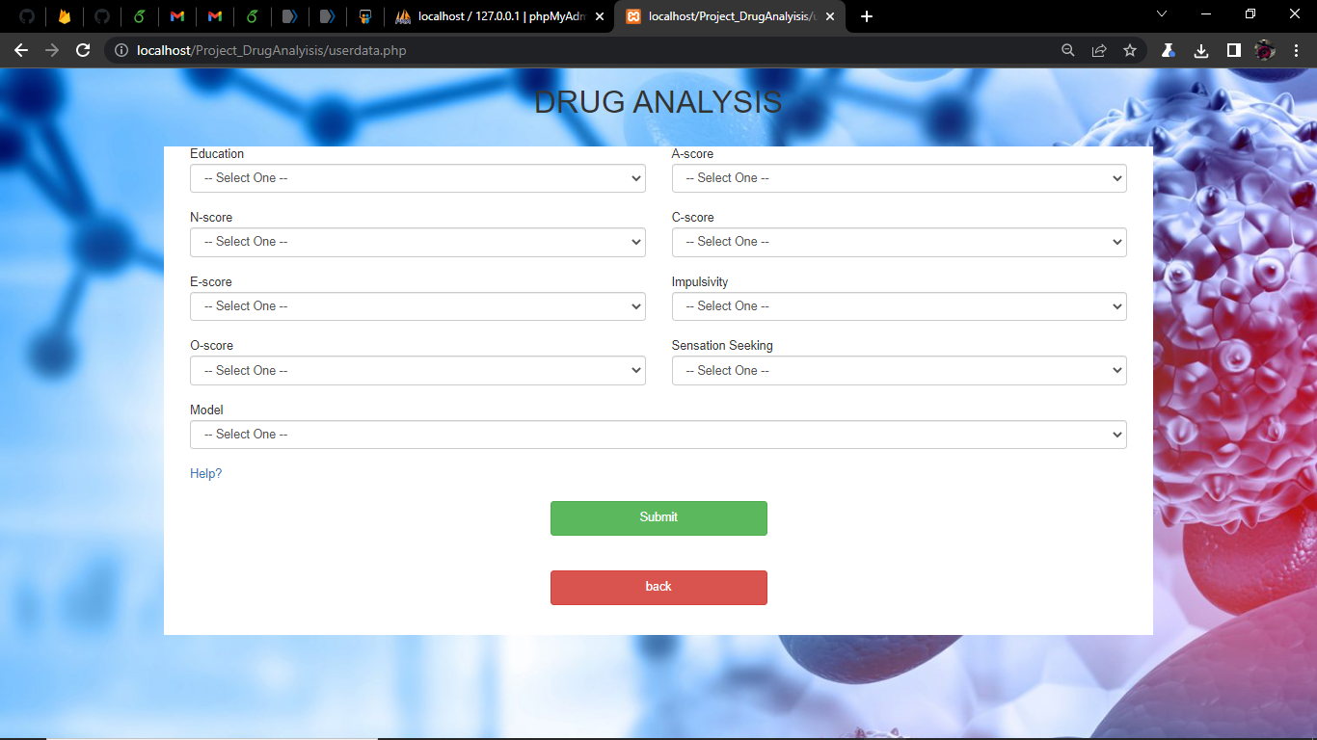

Slide 21
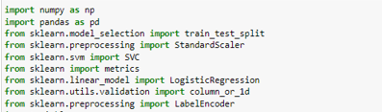
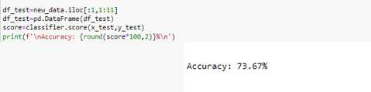
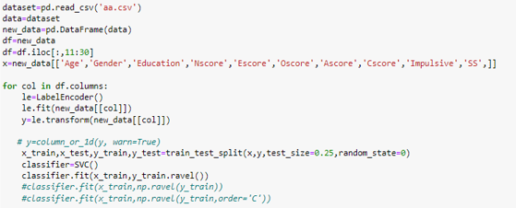
screenshots

Slide 22
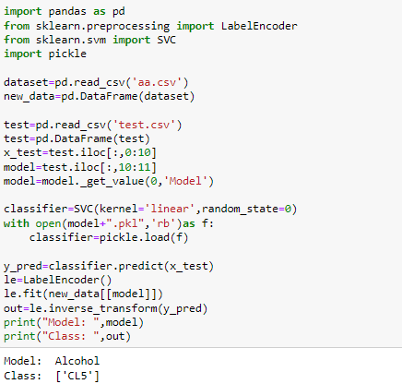
CL0 Never Used
CL1 Used in last year
CL2 Used in last 6 months
CL3 Used within last 2 Months
CL4 Used in Last Month
CL5 Used in Last Week
CL6 Used in Last Day

Slide 23
References
Zhaoying Qiao, Tianrui Chai,Qinjing Zhang,Xinyi Zhou,Zhuoling Chu,‘ Predicting potential drug abusers using machine learning techniques’,IEEE, 13 February 2020
Antonio Terracciano, Corinna E Lockenhoff,Rosa M Crum,O Joseph Bienvenu and Paul T Coasta, ‘Five-Factor Model personality profiles of drug users’,11 April 2008
https://archive.ics.uci.edu/ml/machine-learning-databases/00373/
https://www.lalpathlabs.com/blog/screening-tests-for-drug-abuse

Slide 24
Thank you

